Slide 1
SmallFlow - 080000
Overview

Slide 2
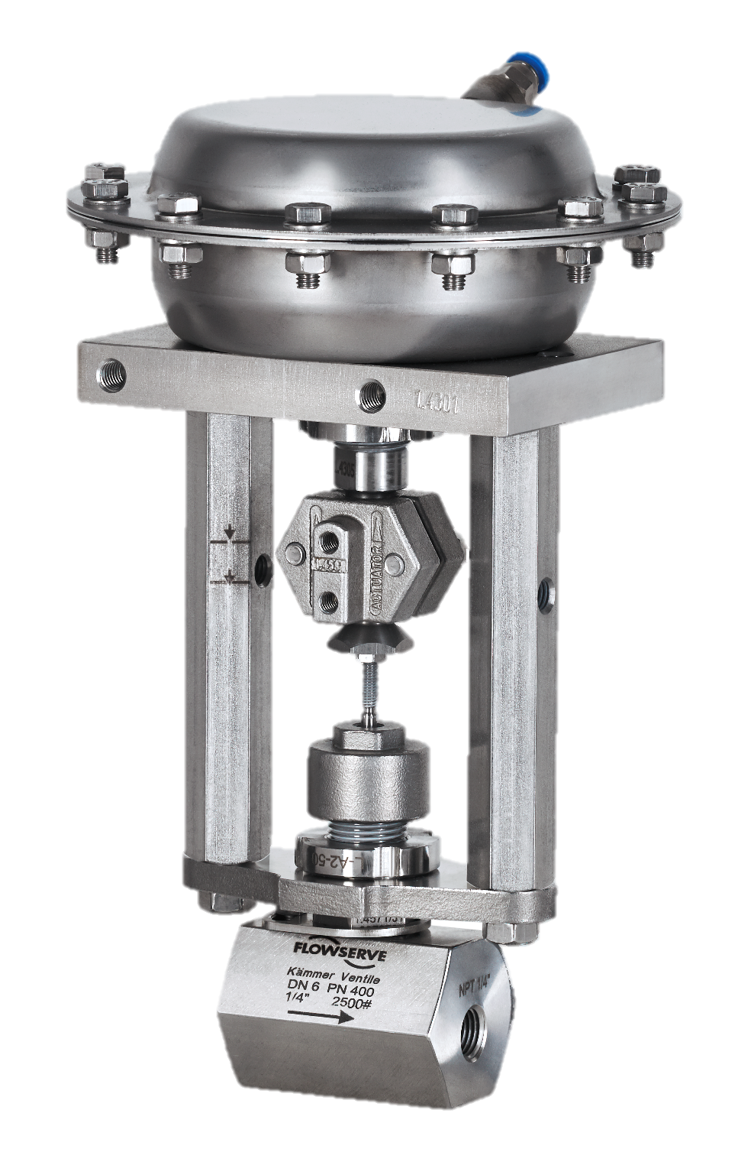
SmallFlow - 080000
Product Overview

Slide 3

SmallFlow – 080000
Technical
Compact
Micro Cv
Flexible
Different bonnet types
Ideal for laboratories and pilot plants

Slide 4
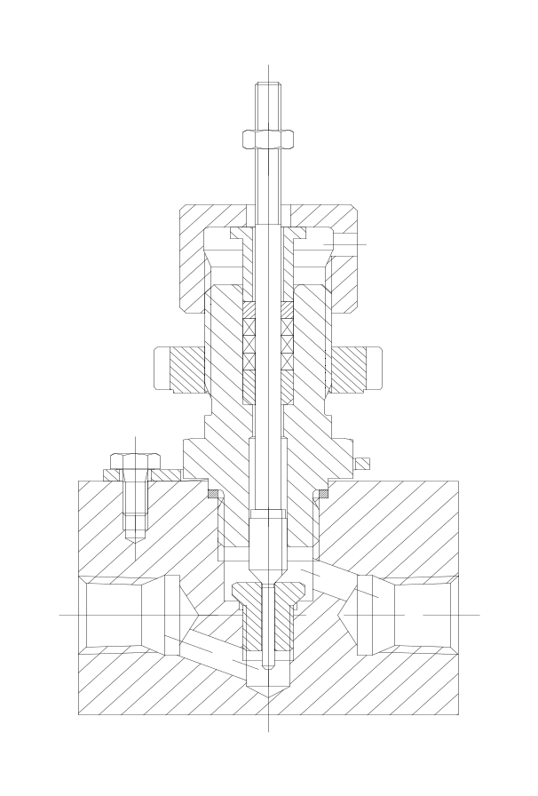
SmallFlow - 080000
Technical
Microflow applications with very low Cv requirements. Reproducible equal percentage characteristic. Chemical injection applications. Small scale plants. Pilot plants.
Large stroke (10mm) for better control.
Safety packing
Size | ¼ inch
Pressure Class | CL 2500 / PN400
Body Materials | 1.4571 Other materials upon request
Body Type | Globe, Angle
End Connections | ¼“ NPT, G ¼“
Cv range | 0.000063 – 0.29
Trim Type | Parabolic low flow
Specials | Very low Cv control
Screwed bonnet
Micro Cv
Plug head guided
screwed seat

Slide 5
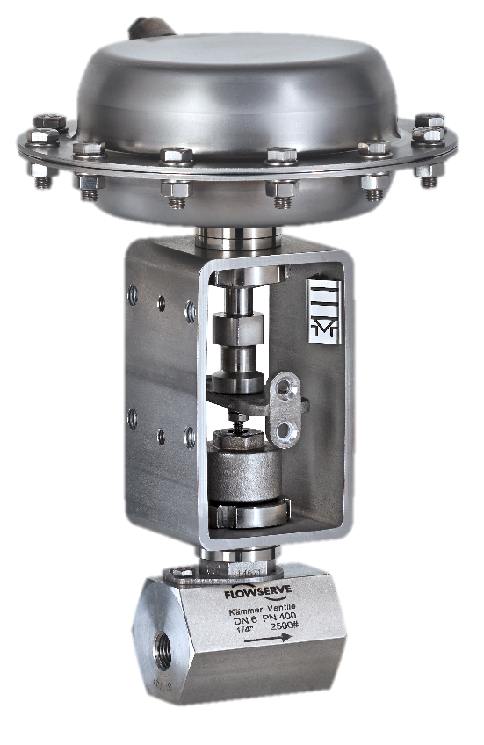

SmallFlow – 080000
Actuator Options
Pneumatic P1
  Fail open / Fail close
  Multispring
  Optional Positioner
  Yoke or yoke rod design
Electric E1
  24V AC / 230V AC
  Self calibrating
  Positioner integrated

Slide 6
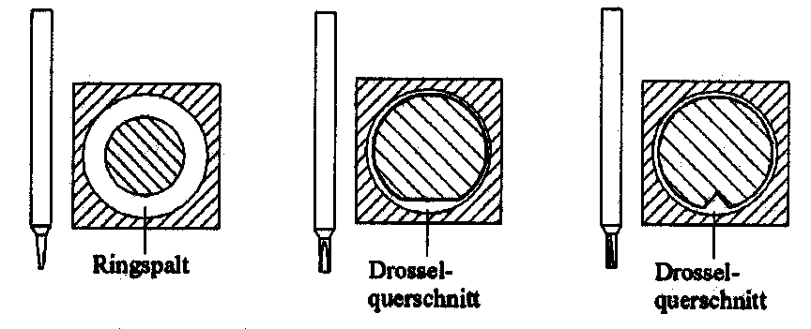
SmallFlow - 080000
Trim Design
Annular gap
Flat throttling
Notch throttling

Slide 7
Thank You
SmallFlow-080000 Overview R00.pptx 14.12.2018 SG

